Slide 1
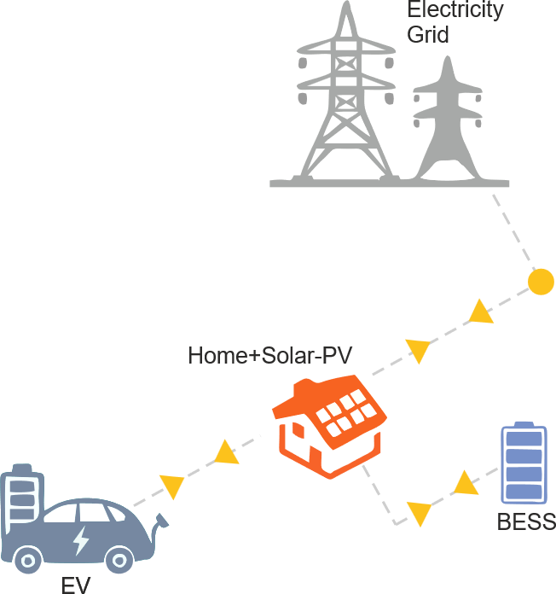
V2H optimization
By AEGIS model
* Adaptive Energy Grid Integration System (AEGIS)

Slide 2
Introduction
Modelling
Case studies
Introduction

Slide 3

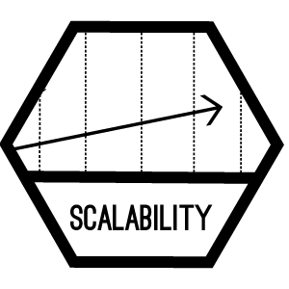



Robust and scalable optimisation model
Simplicity and transparency
Code written to be read by humans (easy to understand)
Highly detailed model documentation
Scalability: from small- to large-scale cases
Careful implementation and orientation to computational efficiency
Numerical stability. Scaling variables and constraints around 1
Tight and compact formulation of some constraints
Developed in Python/Pyomo
Installable as a Python library (pip install opentepes)
Input data and output results in text format (csv)

Slide 4
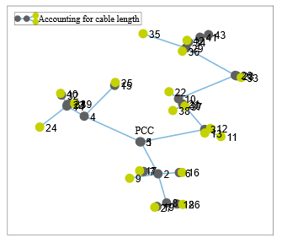
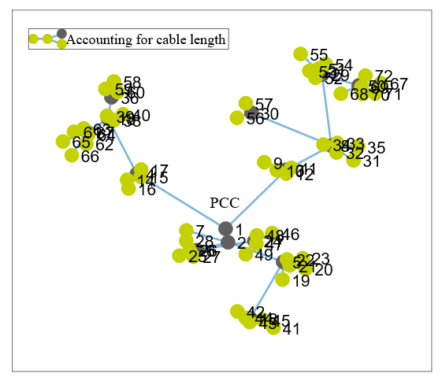
Variety of case studies High temporal and spatial resolution
Standard G1
Standard G2
Case Standard G1
353095 rows, 287962 columns, 902732 nonzeros
Case Standard G2
516224 rows, 683294 columns, 2155482 nonzeros
Case Europe TF2030
39700167 rows, 34702184 columns and 123300396 nonzeros

Slide 5
Introduction
Modelling
Case studies
Modelling

Slide 6
Execution views

Slide 7
Multi-objective and versatility
Optimise operation & investment across markets and networks
Integrate electricity, storage, heat and Power-to-X
O1 – Cost Efficiency
O2 – Multi-Energy Coupling
O4 – Policy & Decision Support
O3 – Adequacy & Flexibility
Provide actionable insights for system operators and regulators
Assess system adequacy and quantify the value of flexibility
* To be expanded

Slide 8

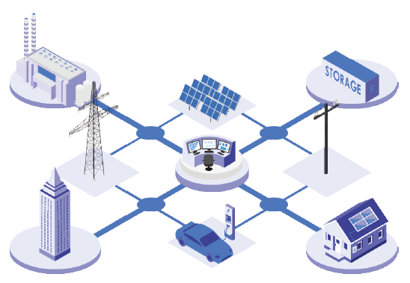


Modelling overview
Bottom-up paradigm
Short- and medium-term analysis
Time domain
Multiyear (dynamic, perfect foresight) scope with 8736 hours/year or representative stages
Period (e.g., year), scenario (e.g., climate year), load level (e.g., hour), stage (e.g., representative days/weeks)
Flexible duration of the time step (e.g., bi-hour, 3-hour, 4-hour time step)
It uses mixed-integer linear programming (solvers GUROBI, CPLEX, HiGHS, GLPK, or CBC)
* To be expanded

Slide 9
Main modelling trade-offs
AEGIS
Time
Decisions
Uncertainty
Space
Period weight
Stage weight
Time step duration
Single node
Transportation model
DC-OPF
3-phase AC-OPF
Binary/continuous
Investment
Operation
Scenario-based
Montecarlo
Markov chains
* To be expanded

Slide 10
Time resolution
Period/year
Period weight allows replication of a year (weight 5 for the year 2030 represents years 2030 up to 2034)
Stage
Optimization problem formulated consecutively for each stage
No constraint connection between two consecutive stages (ramps, up/down time ignored)
Used for creating representative days/weeks
Stage weight allows the replication of each stage (weight 4 of stage/week 1 represents the first moon month)

Slide 11

EV Modelling
Battery & Powertrain
Chemistries: Li-ion (NMC, LFP, etc.)
Parameters: capacity (kWh), SoC dynamics, charge/discharge limits (kW)
Degradation: aging factors (SoC, cycles, temperature)
Efficiency: motors 77-90%, regenerative braking
Mobility & Charging
Trip profiles: departure/arrival, mileage, SoC at return
Availability windows: connected vs. driving
Charging modes: uncontrolled, smart (V1G), bidirectional (V2H, V2G)
Flexibility & System Roles
Household: bill savings, solar PV self-consumption, smart scheduling
Aggregator: fleet optimisation, market participation (balancing, reserves)
System: EVs as flexible demand/storage for adequacy & congestion relief
Financial & Economic Features
Tariff structures: spot/TOU, network fees, taxes, incentives
Peak power charges: monthly demand charges, capacity subscription
Market revenue: exports (V2G), ancillary & capacity markets
Additional costs: battery degradation/replacement, penalties for non-delivery, tariffs
* To be expanded

Slide 12
Output results
Investment: (generation, storage, electric lines, and heat pipes) investment decisions
Operation: unit output and aggregation by technologies (thermal, ESS, RES), RES curtailment, electric line, and heat pipe flows, node voltage angles, ESS inventory levels, power and heat not served
Marginal ¹ : Locational Short-Run Marginal Costs (LSRMC), stored energy value, and minimum RES value
Economic: investment (ROI, IRR, etc.), operation (variable, maintenance, etc.), and reliability costs and revenues from operation
Flexibility: flexibility provided by demand, by the different generation and consumption technologies, and by power not served
1 Computing the marginal information (dual variables) involves solving first with binary variables, fixing them, and rerunning it again.

Slide 13
Introduction
Modelling
Case studies
Case studies

Slide 14
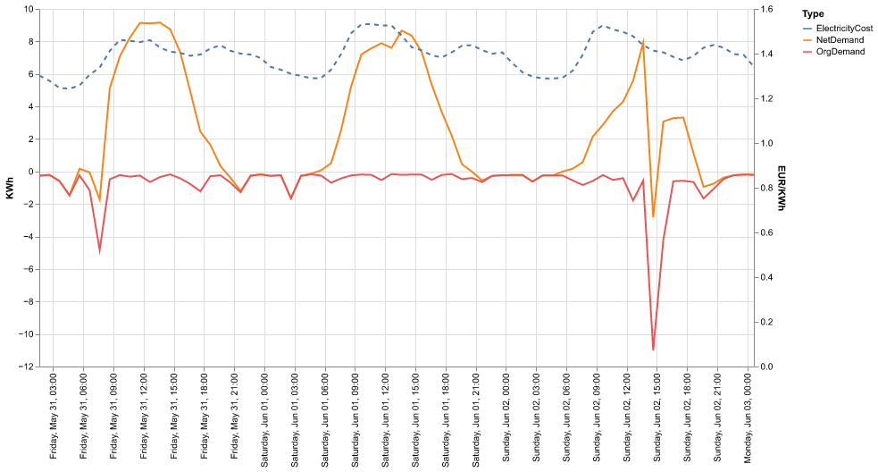
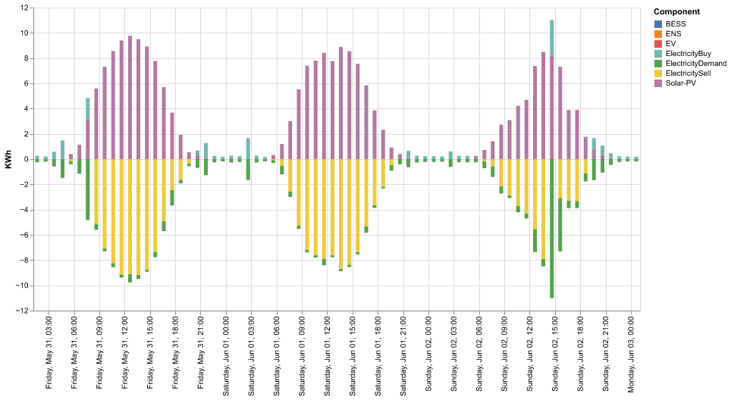
Case 0: Home (Load + Solar PV)
Net demand = solar PV + discharge – charge – Org. demand
+ production/electricity buy
- consumption/electricity sell

Slide 15
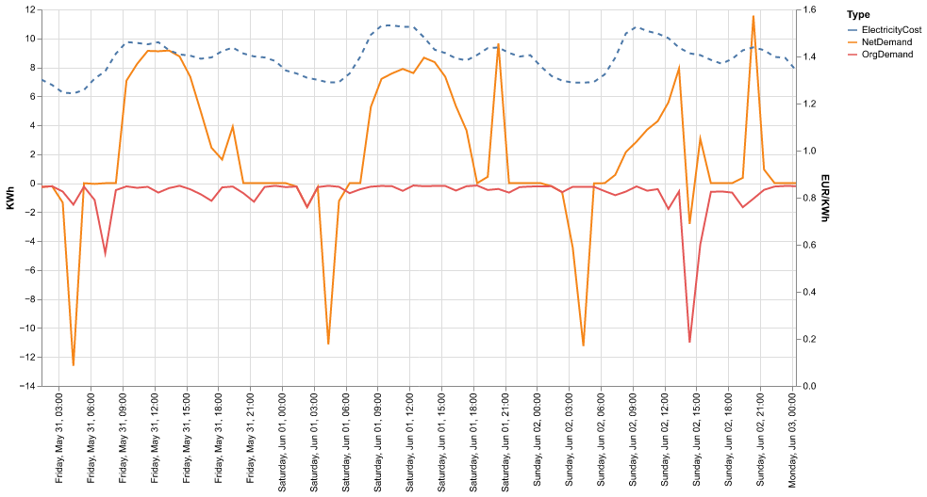
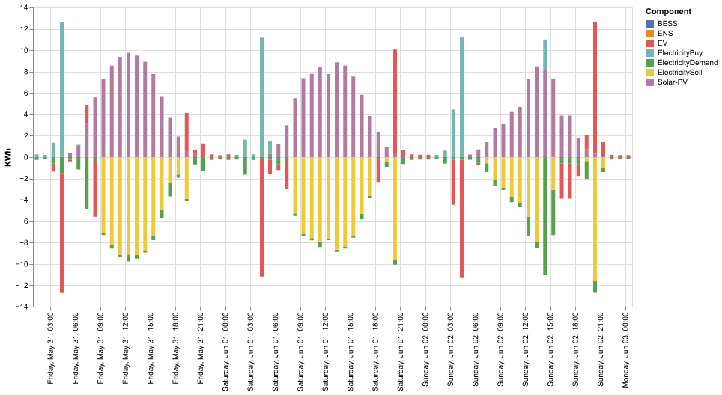
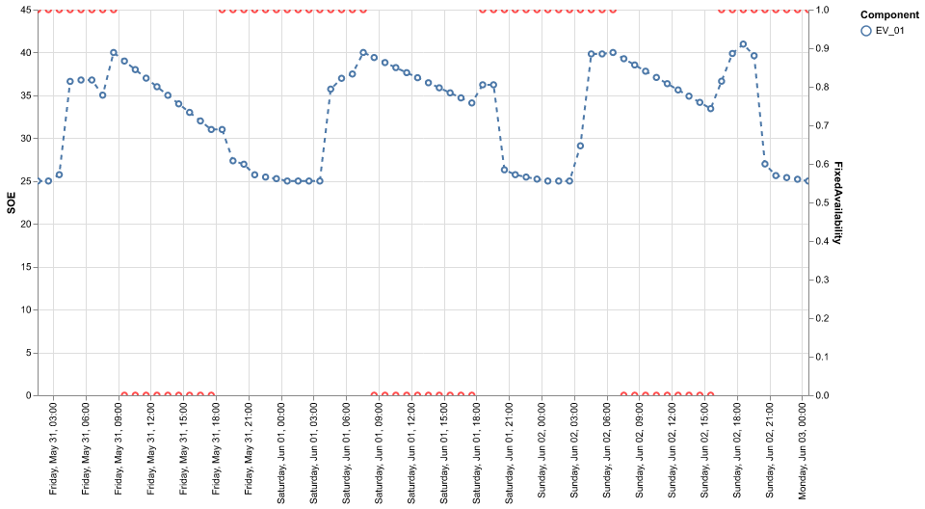
Case 1: Home + EV
Net demand = solar PV + discharge – charge – Org. demand
SOE: State-Of-Energy
+ production/electricity buy
- consumption/electricity sell

Slide 16
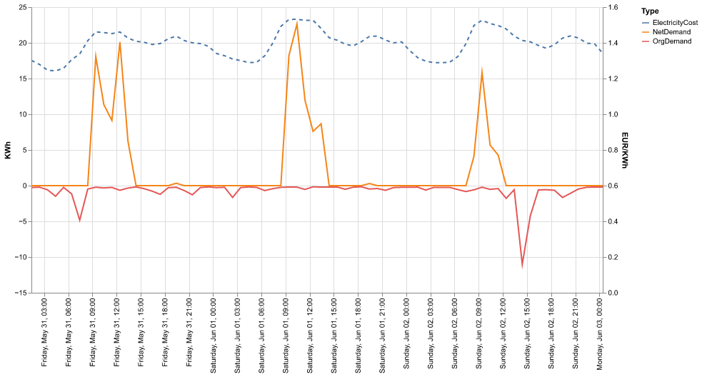
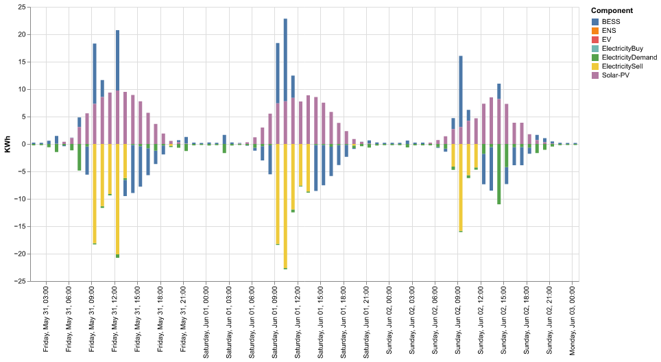
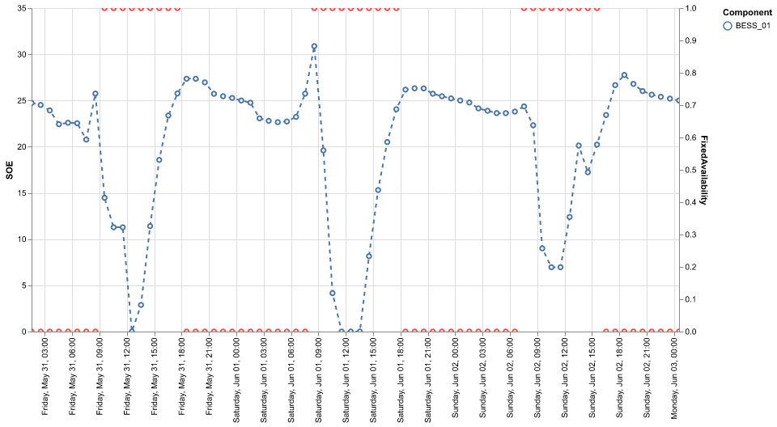
Case 2: Home + BESS
Net demand = solar PV + discharge – charge – Org. demand
SOE: State-Of-Energy
+ production/electricity buy
- consumption/electricity sell

Slide 17
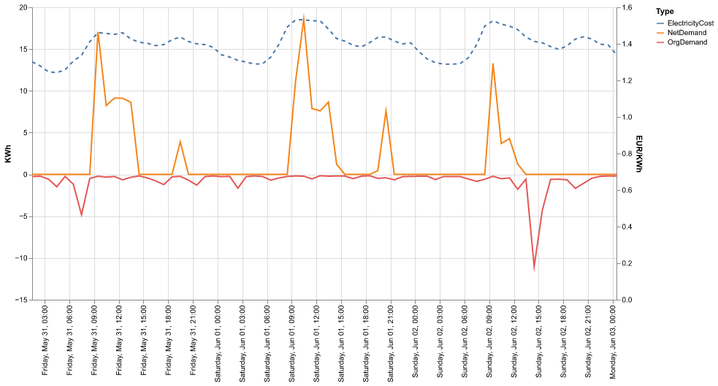
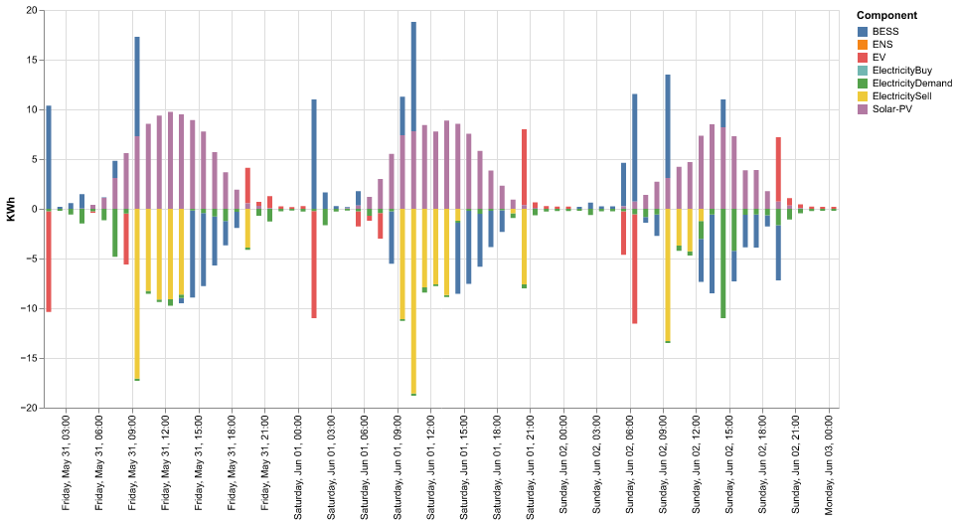
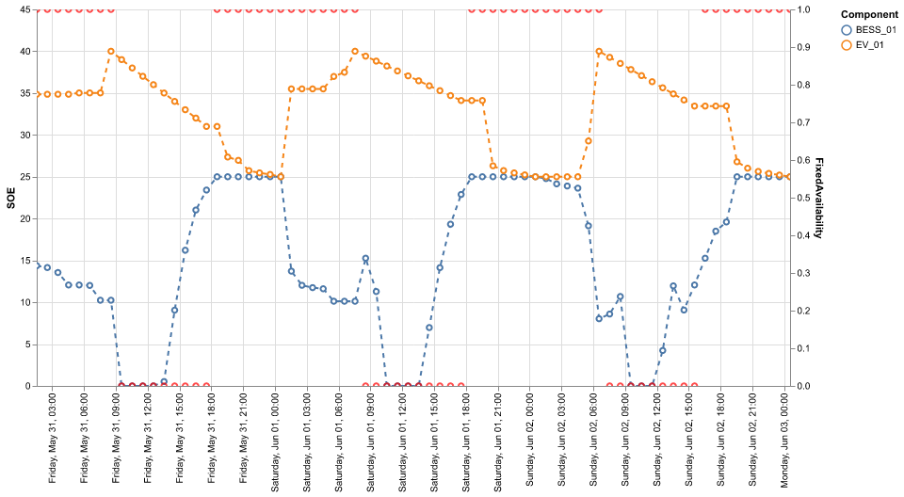
Case 3: Home +EV+ BESS
SOE: State-Of-Energy
+ production/electricity buy
- consumption/electricity sell

Slide 18
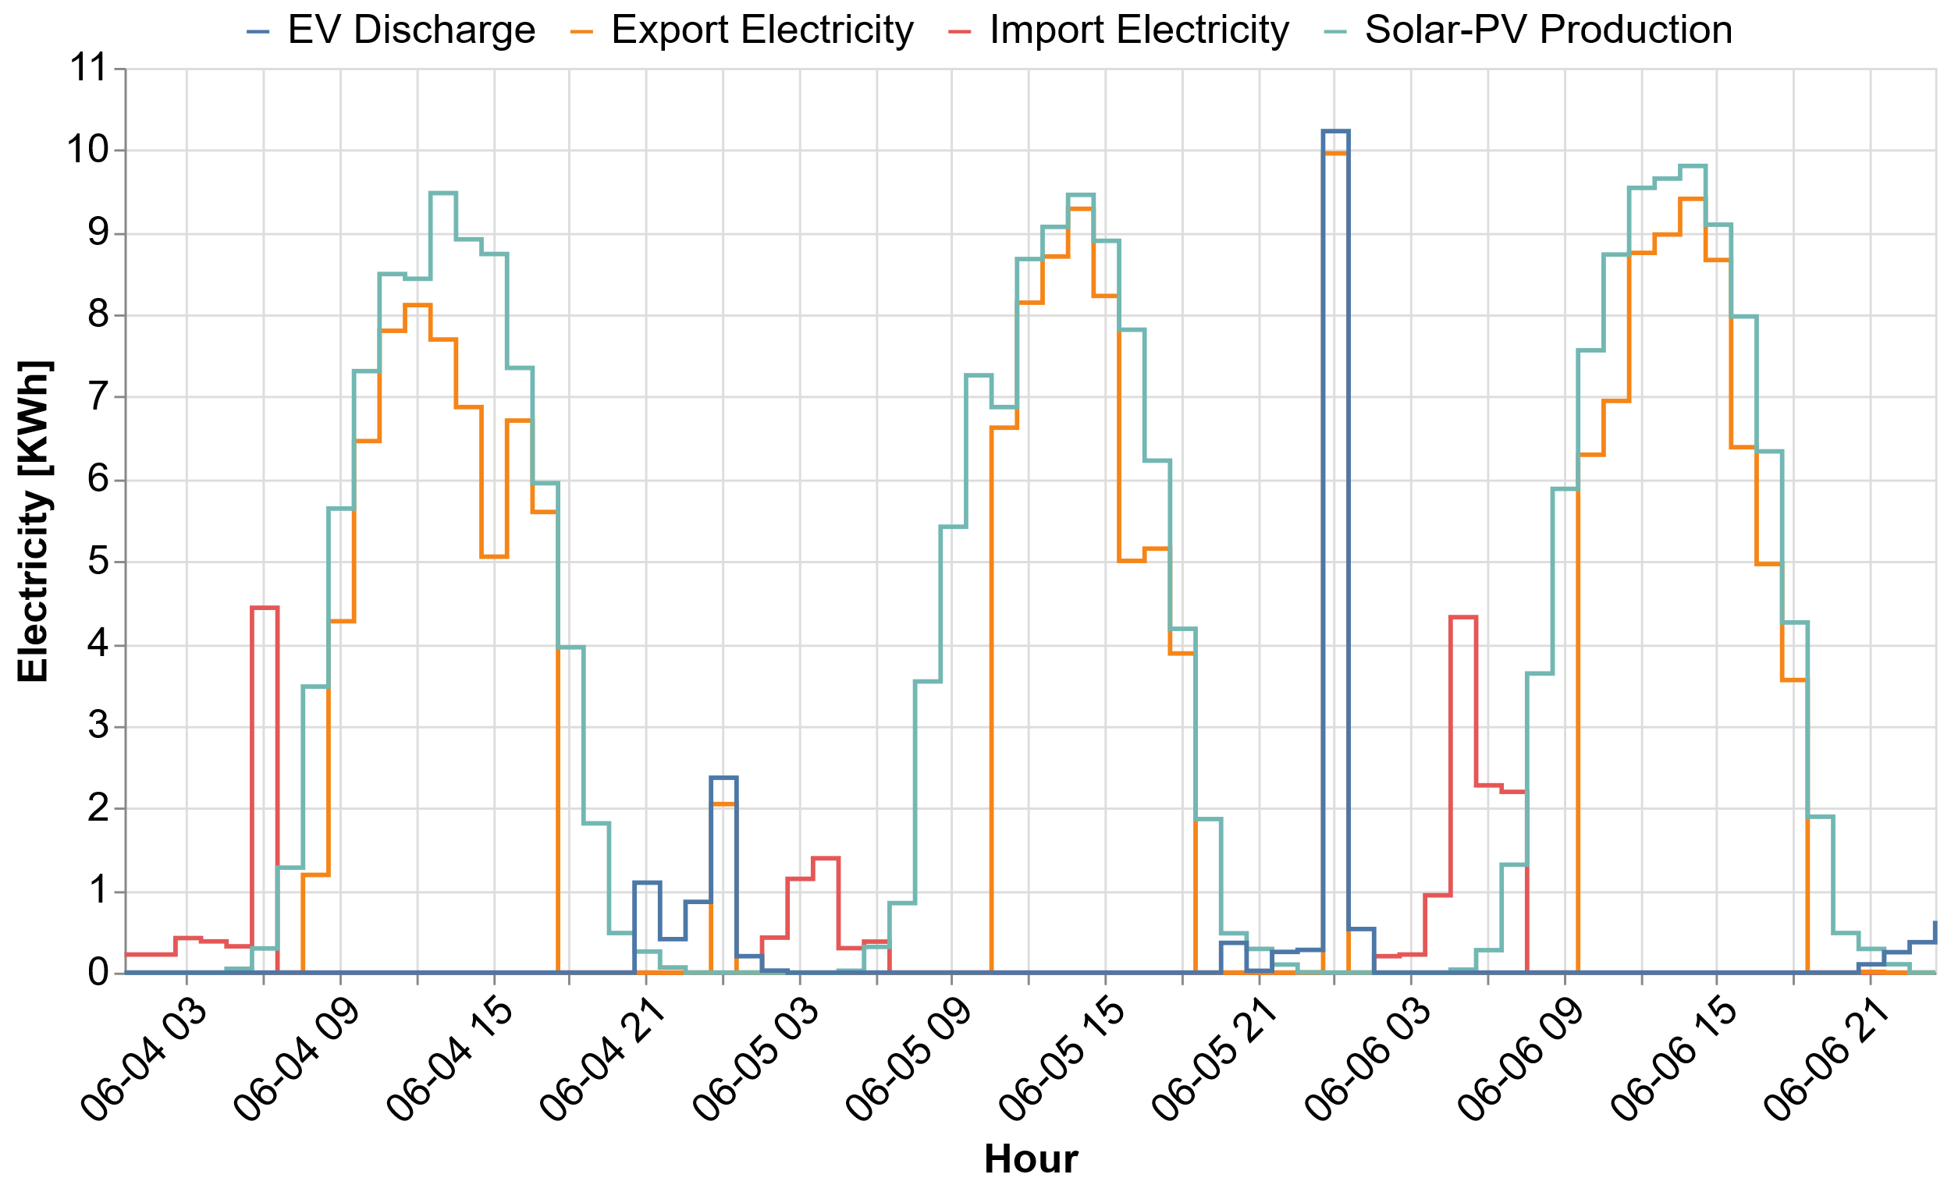
Home optimisation

Slide 19
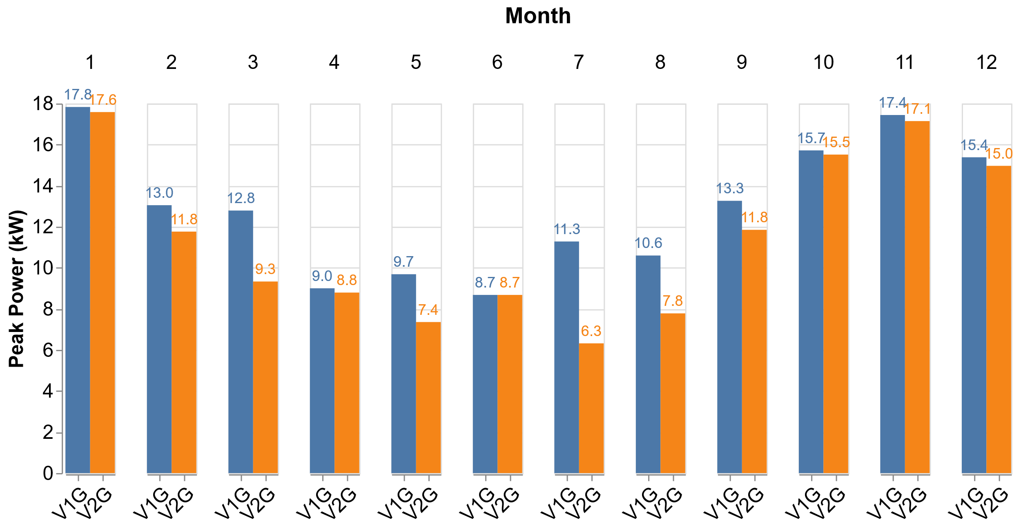
Max. Peak Power Impact of the network fee

